Slide 1
Does Reform Prosecution Increase Crime? A Study from Dallas, TX
Reform Prosecution | Reversing “tough on crime” approach Revising past extreme sentences Harm reduction responses Open and early discovery practices Bail and Marijuana Policy Reform Police Accountability Trauma-Informed Juvenile Justice Restorative Justice
Source: “Issues at a Glance Briefs.” Fair and Just Prosecution. Accessed April 22, 2020. https://fairandjustprosecution.org/resources/issues-at-a-glance-briefs/.
Notes:
Harm reduction responses to drug use: reduce the negative consequences associated with drug use through an approach focused on ameliorating the impact rather than eliminating the conduct alone. Eg sterile syringe access; medication-assisted treatment, distribution of the overdose antidote medication naloxone;
Discovery practices: availability of evidence to the defense in criminal cases, which is controlled by prosecutor

Slide 2

Dallas, TX Case Study Craig Watkins, Dallas County DA
Reform Prosecution | First black District Attorney in TX, 2007 – 2015 Being “smart on crime” Established a Conviction-Integrity Unit, exonerated 19 prisoners in the first year Misdemeanor diversion program for first-time offenders
Source: Buntin, John. “Exoneration Man.” Governing, 2008. https://www.governing.com/poy/Craig-Watkins.html.
Notes:
Memo Agreement plan, a misdemeanor diversion program for first-time offenders (in cases not involving DWI, family violence, or public lewdness), requiring 24 to 30 hours of community service and taking classes in, say, drug education or the social consequences of stealing.

Slide 3
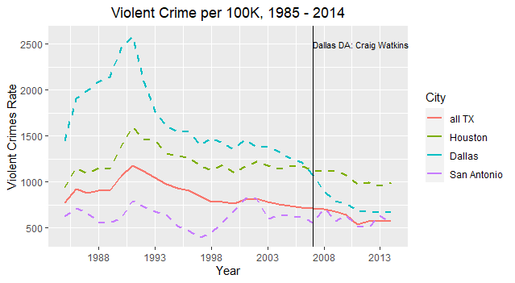
Dallas, TX Case Study Texas Crime Trends

Slide 4
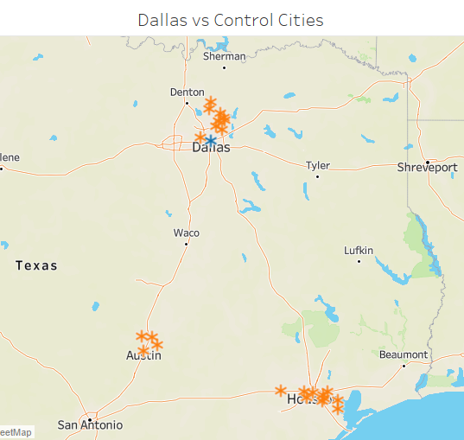

Methodology Matching
 | Find cities that could be comparable “controls” to Dallas in 2007 American Community Survey Data for all TX, 2006 Demographic characteristics, nearest neighbor/propensity score matching

Slide 5
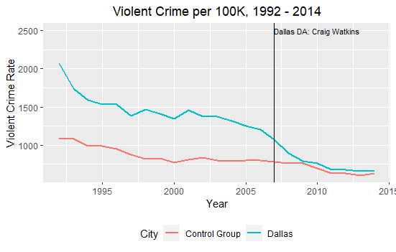
Methodology & Findings Differences-in-Differences
 | Estimated effect: difference in violent crime rates between Dallas and control group, pre and post 2007 Uniform Crime Report Data for all TX, 1992 – 2014

